Slide 1
TiDB: A Raft-based HTAP Database
PVLDB 2020
PingCAP

Slide 2
Introduction
Relational database management systems (RDBMS) are popular with their relational model, strong transactional guarantees, and SQL interface. However, old RDBMSs do not provide scalability and high availability.
NoSQL systems loosen the consistency requirements and provide high scalability and alternative data models, like key-value pairs, graphs, and documents. However, many applications also need strong transactions, data consistency, and an SQL interface.
NewSQL systems provide the high scalability of NoSQL for OnlineTransactional Processing (OLTP) read/write workloads and still maintain ACID guarantees for transactions.
SQL-based Online Analytical Processing (OLAP) systems are being developed quickly, like many SQL-on-Hadoop systems.

Slide 3
Introduction
These systems use different data models and technologies for the different purposes of OLAP and OLTP. However, multiple systems are very expensive to develop, deploy, and maintain.
Freshness means how recent data is processed by the analytical queries. Analyzing the latest data in real time has great business value. But it is not guaranteed in some HTAP solutions, such as those based on an Extraction-Transformation-Loading (ETL) processing.
Isolation refers to guaranteeing isolated performance for seperate OLTP and OLAP queries. To guarantee isolated performance, it is necessary to run OLTP and OLAP requests on different hardware resources. Some in-memory databases (such as HyPer) provide fresh data, it cannot achieve high performance for both OLTP and OLAP due to data synchronization penalties and workload interference.
HTAP systems need to efficiently read the latest data to guarantee the throughput and latency for OLTP and OLAP requests

Slide 4
Contribution
We propose building an HTAP system based on consensus algorithms and have implemented a Raft-based HTAP database,TiDB. It is an open-source project that provides high availability, consistency, scalability, data freshness, and isolation for HTAP workloads.
We introduce the learner role to the Raft algorithm to generate acolumnar store for realtime OLAP queries.
We implement a multi-Raft storage system and optimize its reads and writes so that the system offers high performance when scaling to more nodes.
We tailor an SQL engine for large-scale HTAP queries. The engine can optimally choose to use a row-based store and a columnar store.
We conduct comprehensive experiments to evaluate TiDB’s performance about OLTP , OLAP , and HTAP using CH-benCHmark,an HTAP benchmark.

Slide 5
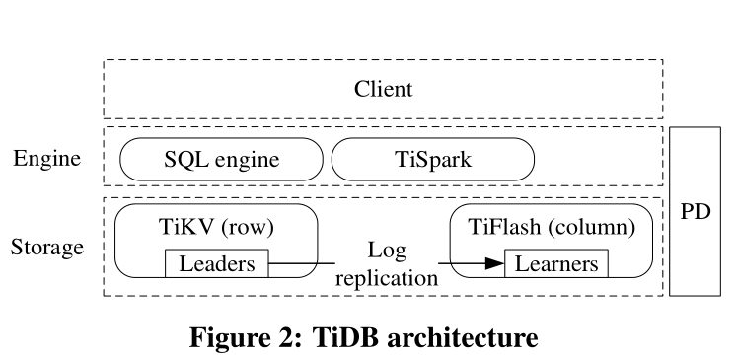
ARCHITECTURE
distributed storage layer:
Tikv
the data stored in TiKV is an ordered key-value map.
Key:{table{tableID} record{rowID}}
Value: {col0, col1, col2, col3}
TiFlash
Region: split the large key-value map into many contiguous ranges, each of which is called a Region.
Isolation: TiKV and TiFlash can be deployed in separate physical resources and thus offer isolation when processing transactional and analytical queries.

Slide 6
ARCHITECTURE
PD:
manage Regions:
supply each key’s Region and physical location
automatically moving Regions to balance workloads.
Assign timestamp: providing strictly increasing and globally unique timestamps. (transaction IDs)

Slide 7
ARCHITECTURE
computation engine layer:
cost-based query optimizer
distributed query executor

Slide 8
Challenge
How to build a scalable Raft storage system to support highly concurrent read/write?
If the amount of data exceeds the available space on each node managed by the Raft algorithm, we need a partition strategy to distribute data on servers.
In the basic Raft process, requests are processed sequentially, this process involves network and disk operations, this overhead makes the leader become a bottleneck to processing requests, especially on large datasets.
How to synchronize logs into learners with low latency to keep data fresh? Transforming log data into column format may encounter errors due to mismatched schemas. This may delay log synchronization.
How to efficiently process both transactional and analytical queries with guaranteed performance? To reduce execution overhead, they also need to choose optimal plans on both a row-format store and a column-format store.

Slide 9
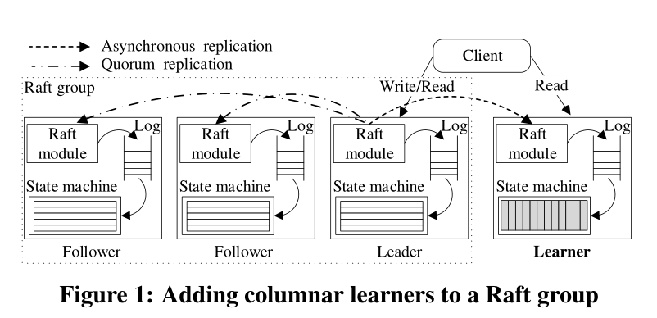
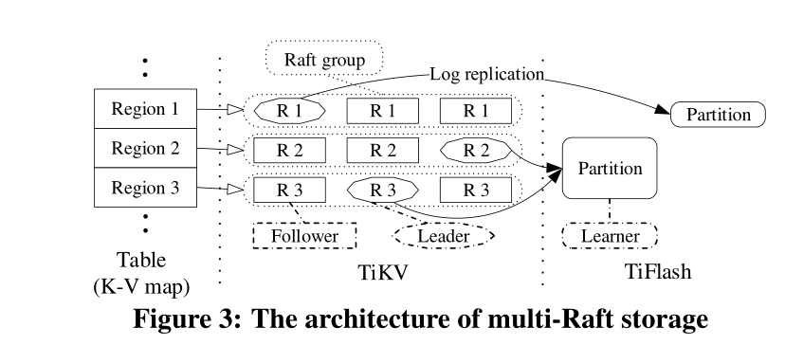
Multi Raft
Region: split the large key-value map into many contiguous ranges, each of which is called a Region. Raft leader handles read/write requests for the corresponding Region.
TIDB introduced a learner role to the Raft consensus algorithm. A learner does not participate in leader elections, nor is it part of a quorum for log replication. Log replication from the leader to a learner is asynchronous; the leader does not need to wait for success before responding to the client.
Multiple Regions can be merged into one partition when data is replicated to TiFlash to facilitate table scan.

Slide 10
TIKV
Basic Raft process :
A Region leader receives a request from the SQL engine layer.
The leader appends the request to its log.
The leader sends the new log entries to its followers, which in turn append the entries to their logs.
The leader waits for its followers to respond. If a quorum of nodes respond successfully, then the leader commits the request and applies it locally.
The leader sends the result to the client and continues to process incoming requests.
Problem:
Can not provide efficient performance because the steps happen sequentially
may incur large I/O overheads (both disk and network)

Slide 11
Technique
Optimization between Leaders and Followers:
the leader appends logs locally and sends logs to followers at the same time
leader buffers log entries and sends them to its followers in batches
After sending the logs, the leader does not have to wait for the followers to respond. Instead, it can assume success and send further logs with the predicted log index.
leader applying committed log entries can be handled asynchronously by a different thread
the Raft process is updated as follows:
A leader receives requests from the SQL engine layer.
The leader sends corresponding logs to followers and appends logs locally in parallel.
The leader continues to receive requests from clients and repeats step (2).
The leader commits the logs and sends them to another thread to be applied.
After applying the logs, the leader returns the results to the client.

Slide 12
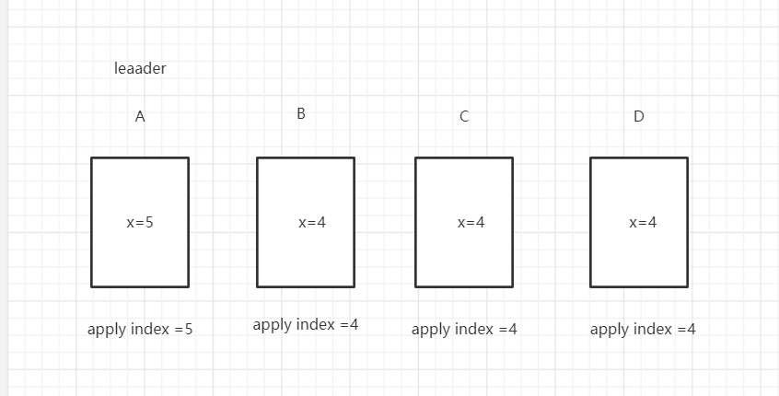
Technique
Linearizable semantics: when a value is read at time t from a Region leader, the leader must not return a previous version of the value for read requests after t. (transform leader or network partition)
Accelerating Read Requests from Clients:
issuing a log entry for every read request and waiting for that entry to be applyed before returning.
read index:
records the current commit index as a local read index
sends heartbeat messages to followers to confirm its leader role
return the value once its applied index is greater than or equal to the read index
lease read:
leader and followers agree on a lease period, during which followers do not issue election requests so that the leader is not changed.

Slide 13
Technique
Managing Massive Regions
The servers and data size are dynamically changing, and Regions may cluster in some servers, especially leader replicas. This causes some servers’ disks to become overused, while others are free.
PD places at least three replicas of a Region on different TiKV instances to ensure high availability,.
PD migrates hot Regions to different servers without impacting applications.
maintaining massive Regions involves sending heartbeats and managing metadata, However, if a Raft group does not have any workloads, the heartbeat is unnecessary.
Dynamic Region Split and Merge
A large Region may become too hot to be read or written in a reasonable time. Hot or large Regions should be split into smaller ones to better distribute workload.
Many Regions are small and seldom accessed. The system still needs to maintain the heartbeat and metadata . It is necessary to merge smaller Regions.

Slide 14
Technique
Split process:
PD issues a split command to the leader of a Region.
After receiving the split command, the leader transforms the command into a log and replicates the log to all its follower nodes. The log only includes a split command, instead of modifying actual data.
Once a quorum replicates the log, the leader commits the split command, and the command is applied to all the nodes in the Raft group. The apply process involves updating the original Region’s range and epoch metadata, and creating new Regions to cover the remaining range. Note that the command is applied atomically and synced to disk.
For each replica of a split Region, a Raft state machine is created and starts to work, forming a new Raft group. The leader of the original Region reports the split result to PD. The split process completes.
After a split command finishes, the newly split Regions may be moved across servers due to PD’s regular load balancing.
Merge process:PD moves replicas of the two Regions to colocate them on separate servers. Then, the colocated replicas of the two Regions are merged locally on each server through a two-phase operation; that is, stopping the service of one Region and merging it with another one.

Slide 15
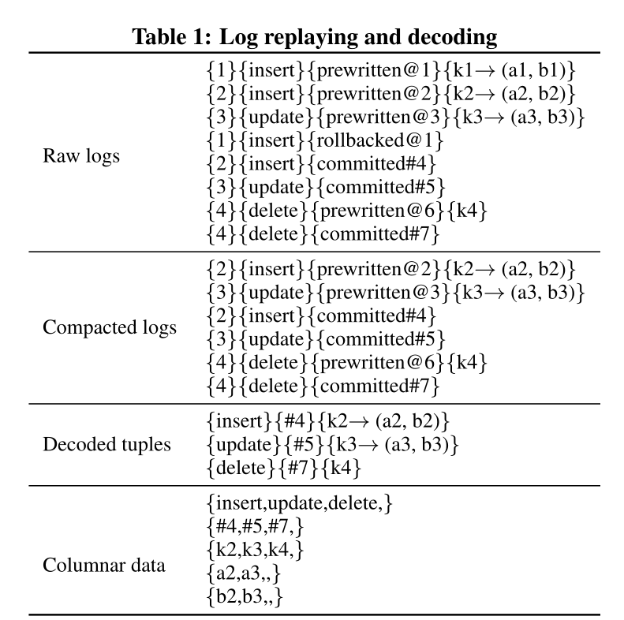
Technique(TiFlash)
Log Replayer:
Compacting logs: According to the transaction model described in later Section 5.1, the transactional logs are classified into three statuses: prewritten, committed, or rollbacked. The data in the rollbacked logs does not need to be written to disks, so a compact process deletes invalid prewritten logs according to rollbacked logs and puts valid logs into a buffer.
Decoding tuples: The logs in the buffer are decoded into row-format tuples, removing redundant information about transactions. Then, the decoded tuples are put into a row buffer.
Transforming data format: If the data size in the row buffer exceeds a size limit or its time duration exceeds a time interval limit, these row-format tuples are transformed to columnar data and are written to a local partition data pool. Transformation refers to local cached schemas, which are periodically synchronized with TiKV as described later

Slide 16
Technique(TiFlash)
Schema Synchronization:
Regular synchronization: the schema syncer fetches the newest schema from TiKV periodically and applies changes to its local cache. In most cases, this casual synchronization reduces the frequency of synchronizing schemas.
Compulsive synchronization: if the schema syncer detects a mismatched schema, it proactively fetches the newest schema from TiKV . This can be triggered when the column number differs between tuples and schemas or a column value overflows.

Slide 17
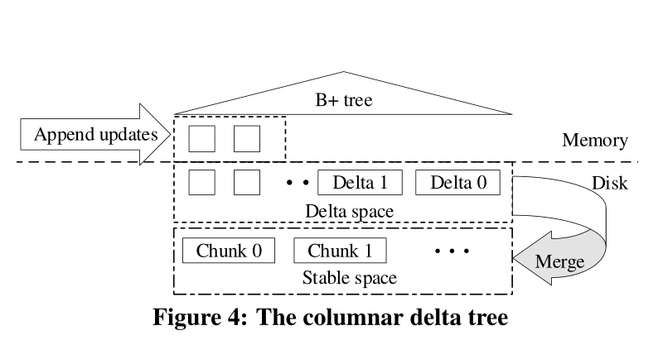
Technique(TiFlash)
Columnar Delta Tree:
New incoming deltas are an atomic batch of inserted data or a deleted range. These deltas are cached into memory and materialized into disks.
periodically compact these small deltas into a larger one, then flush the larger deltas to disks and replace the previously materialized small deltas.
periodically merge the deltas into the stable space.
build a B+ tree index on the top of the delta space. Each delta item of updates is inserted into the B+ tree ordered by its key and timestamp.

Slide 18
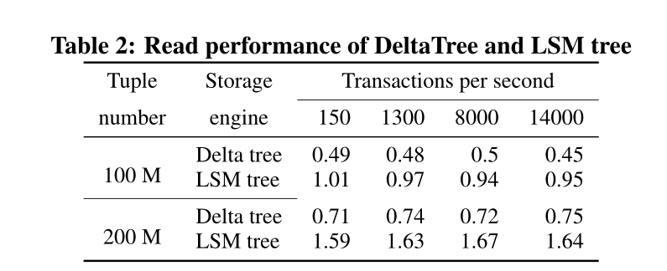
Technique(TiFlash)

Slide 19
Technique(HTAP)
implement optimistic and pessimistic locking in a distributed cluster
SQL engine accelerates analytical queries by using a rule- and cost-based optimizer, indexes, and pushing down computation to the storage layer
implement TiSpark to connect with the Hadoop ecosystem and enhance OLAP capability.
the SQL engine and TiSpark benefit from using both row and column stores at the same time to get optimal results.

Slide 20
Technique(OLTP)
TiDB provides ACID transactions with snapshot-isolation (SI) or repeatable read (RR) semantics. RR means that different statements in a transaction might read different values for the same key, but that repeating a read (i.e., two reads with the same timestamp) will always read the same value.
The responsibility of each component during transaction is as follows:
SQL engine: coordinates transactions. It receives the write and read requests from clients, transforms data into a key-value format, and writes the transactions to TiKV using two-phase commit (2PC).
PD: manages logical Regions and physical locations; provides global, strictly-increasing timestamps.
TiKV: provides distributed transaction interfaces, implements MVCC, and persists data to disk.

Slide 21
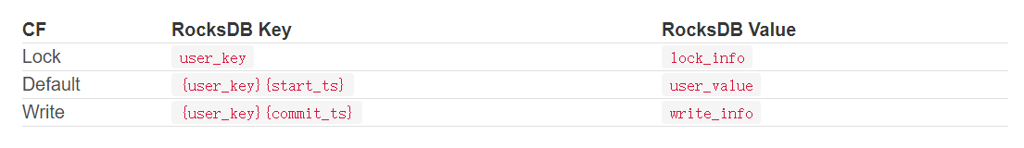
Technique(OLTP)
MVCC:
Lock :锁信息，lock_info包括lock type、primary key、timestamp等
Write:包含commit的时间戳，write_info包括write type、start_ts 等。
Default:数据存放的位置，包括key,事物开始的时间戳，value
RR:假设事物开始的时间为start_ts,那么就只能读到commit_ts<=start_ts的数据。

Slide 22
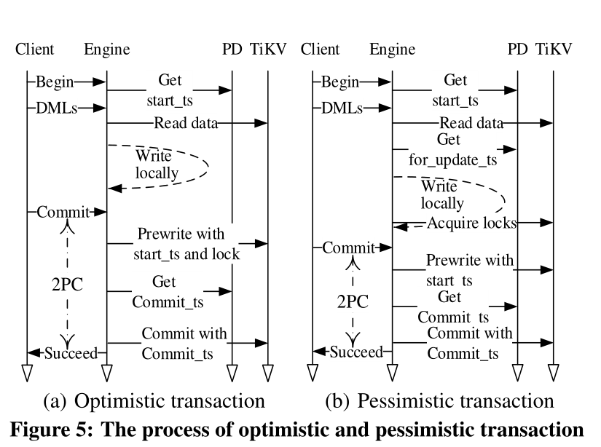
Technique(OLTP)
(1) After receiving a “begin” command from a client, the SQL engine asks PD for a timestamp to use as the start timestamp(start ts) of the transaction.
(2) The SQL engine executes SQL DMLs by reading data from TiKV and writing to local memory. TiKV supplies data with the most recent commit timestamp (commit ts) before the transaction’s start ts.
(3) When the SQL engine receives a commit command from the client, it starts the 2PC protocol. It randomly chooses a primary key, locks all keys in parallel, and sends prewrites to TiKV nodes.
(4) If all prewrites succeed, the SQL engine asks PD for a timestamp for the transaction’s commit ts and sends a commit command to TiKV . TiKV commits the primary key and sends a success response back to the SQL engine.
(5) The SQL engine returns success to the client.
(6) The SQL engine commits secondary keys and clears locks asynchronously and in parallel by sending further commit commands to TiKV

Slide 23
Technique(OLAP)
Query Optimization in SQL Engine:
TiDB implements a query optimizer with two phases of query optimisation: rule-based optimization (RBO) of the query which produces a logical plan, then cost-based optimization (CBO) which transforms a logical plan to a physical plan.
TiDB implements scalable indexes to work in a distributed environment. Indexes are split by Regions in the same way as data and stored in TiKV as key-values.
Physical plans can be further optimized by pushing down some computation to the storage layer.(TopN)

Slide 24
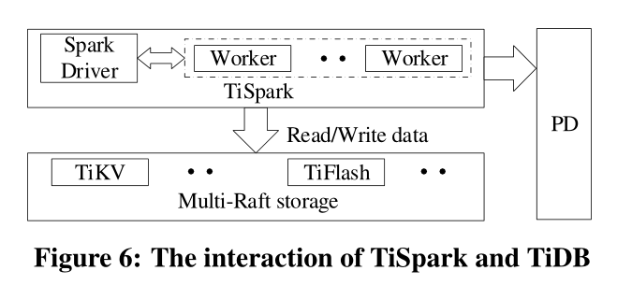
Technique(OLAP)
Tispark:
TiDB adds TiSpark on the multi-Raft storage. TiSpark supports powerful computation such as machine learning libraries and can process data from outside TiDB.

Slide 25
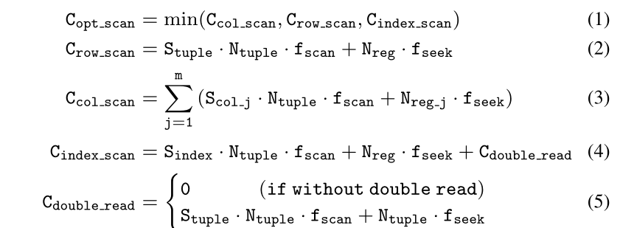
Technique(HTAP)
Isolation and Coordination:
Analytical queries often consume high levels of resources such as CPU, memory, and I/O bandwidth. If these queries run together with transactional queries, the latter can be seriously delayed.
Transactional queries mainly access TiKV, whereas analytical queries mainly access TiFlash.
Data is consistent across TiKV and TiFlash, therefore queries can be served by either reading from TiKV or TiFlash. As a result, our query optimizer can choose from a larger physical plan space, and the optimal plan can potentially read from both TiKV and TiFlash. When TiKV accesses a table, it provides a row scan and an index scan, and TiFlash supports a column scan.
Stuple:the average tuple/column/index size
Ntuple:estimated number of tuples/Region
Fscan: the I/O overhead of the data scan
Fseek: the file seeking cost

Slide 26
Experiment
Cluster:
six servers
188 GB memory
two Intel ® Xeon ®CPU E5-2630 v4 processors, 10 physical cores (20 threads) and a 25 MB shared L3 cache
Centos version 7.6.1810
10 Gbps Ethernet network.
Workload
hybrid OLTP and OLAP workload using CH-benCHmark.
unit of data in CH-benCHmark is called a warehouse
100 warehouses take about 70 GB of memory.

Slide 27
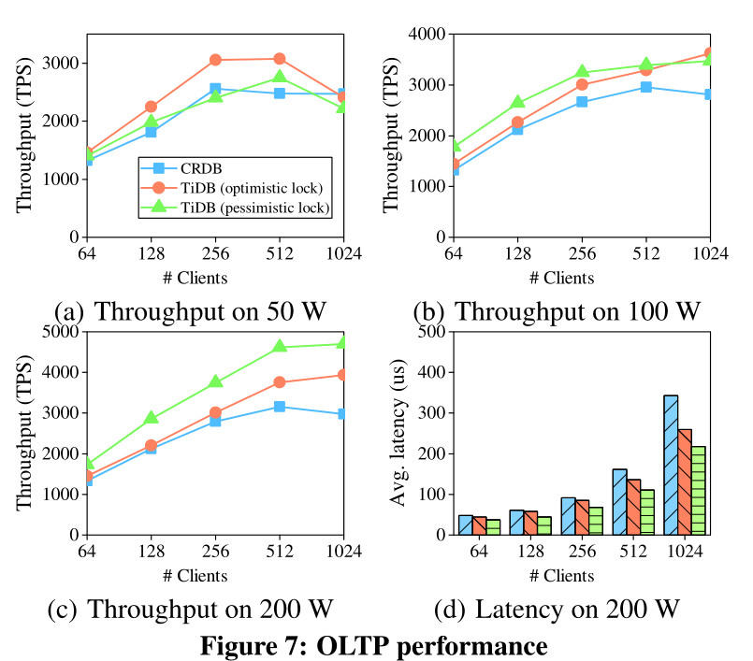
Experiment
7(a), for less than 256 clients, the throughput of TiDB increases with the number of clients for both optimistic locking and pessimistic locking.
For more than 256 clients, the throughput with optimistic locking remains stable and then starts to drop, whereas the throughput of pessimistic locking reaches its maximum with 512 clients and then drops.
The throughput of TiDB in Figures 7(b) and 7(c) keeps increasing.
more clients cause more latency, especially after reaching maximum throughput, because more requests have to wait for a longer time.

Slide 28
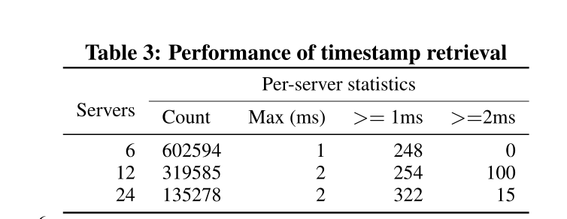
Experiment
When running TPC-C, TiDB requests at most 6000 timestamps per second per server.
the total number of timestamps is almost the same.
Only a small proportion of requests cost 1 ms or 2 ms.
getting timestamps from PD is not a performance bottleneck in TiDB at present.

Slide 29
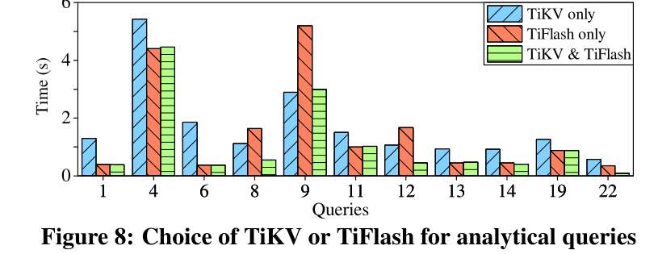
Experiment
fetching data only from a single kind of store, neither store is superior. Requesting data from both TiKV and TiFlash always performs better.

Slide 30
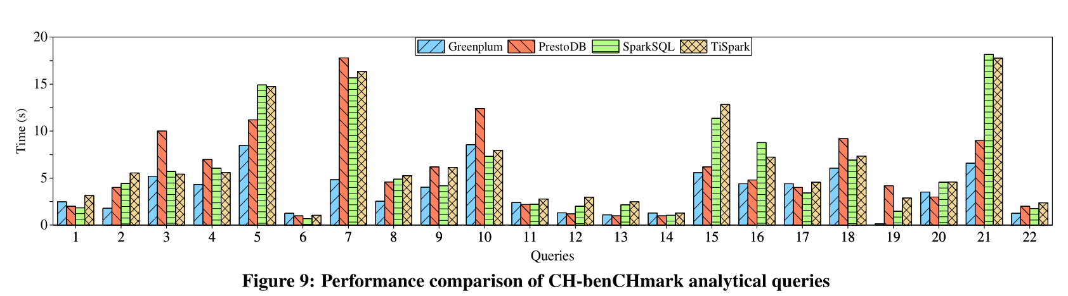
Experiment

Slide 31
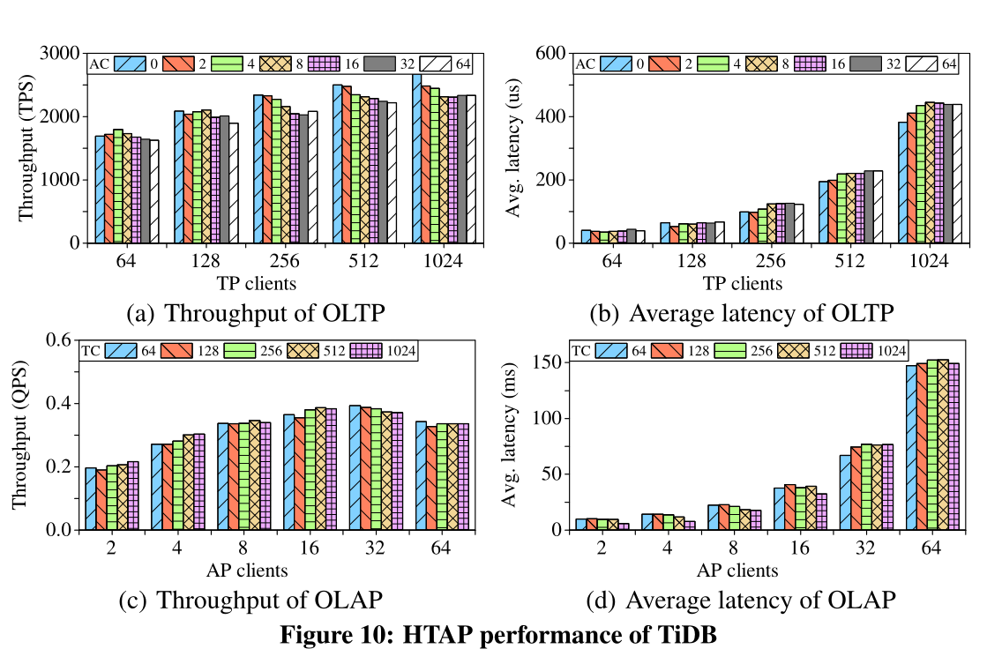
Experiment
10(a) and 10(b): The throughput increases with more TP clients but reaches the maximum value at slightly less than 512 clients.
more analytical processing clients degrade the TP throughput at most 10% compared to no AP clients.
10(c) and 10(d):The AP throughput soon reaches the maximum under 16 AP clients, because AP queries are expensive and compete for resources.
With the same number of AP clients, the throughput remains almost the same, with at most only a 5% drop.

Slide 32
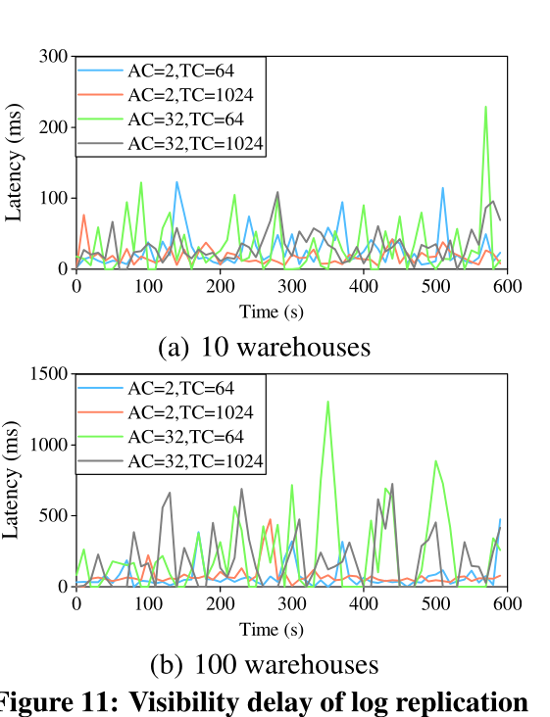
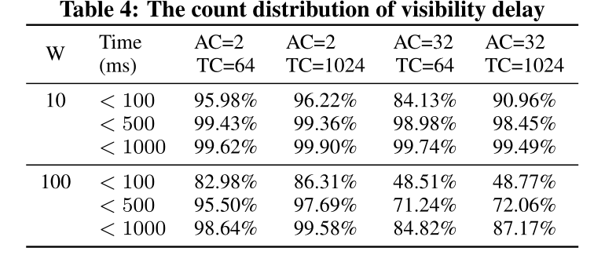
Experiment

Slide 33
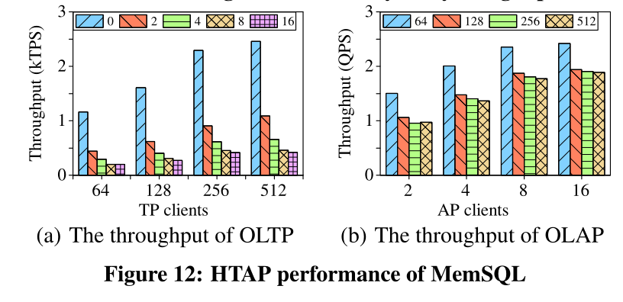
Experiment
as the number of AP clients increase, the transaction throughput significantly slows, dropping by more than five times.
The AP throughput also decreases with more TP clients, but such an effect is not as marked, because transaction queries do not require the massive resources of analytical queries.

Slide 34

Q & A
Thank You!

